Slide 1
Software Systems Design and Integration
Lecture 12: JMS and Message EJBs

Slide 2
Aims
Understand the role of asynchronous communications in enterprise applications
Describe the main components of the JMS API
Learn the technology for building Java EE messaging applications using EJBs
Acquire practical skiils the process of creating messaging beans, writing event handlers and JMS clients

Slide 3
Content
Introduction: Messaging Applications
Java EE Messaging Applications
JMS API
Using JMS API for processing messages in J2EE applications
Message beans as asynchronous consumers in Java EE applications
Developing Message EJBs
Developing remote JMS Clients of Java EE Applications

Slide 4
1 Introduction: Messaging Applications
Message Distribution – different models of broadcasting
  Point-to-point
  Publish/subscribe
Physical Connection – different protocols for communication
Communication Session – different modes of processing
  Synchronous
  Asynchronous
  Synchronous/Asynchronous

Slide 5
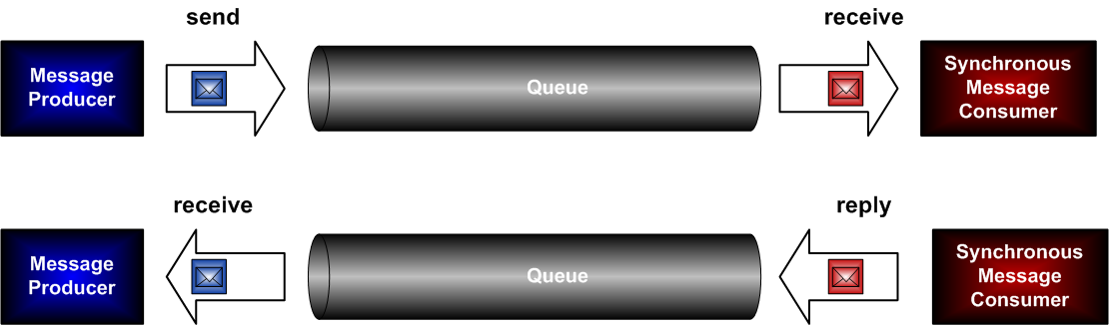
Synchronous Messaging
All messages are exchanged within one single session of communication
Stateful protocol needed (based on TCP sockets, IIOP, or similar – i.e., FTP, CORBA, RMI, RTP,etc.)
Communication channel occupied during the entire session
Very simple on both client-side and server-side

Slide 6
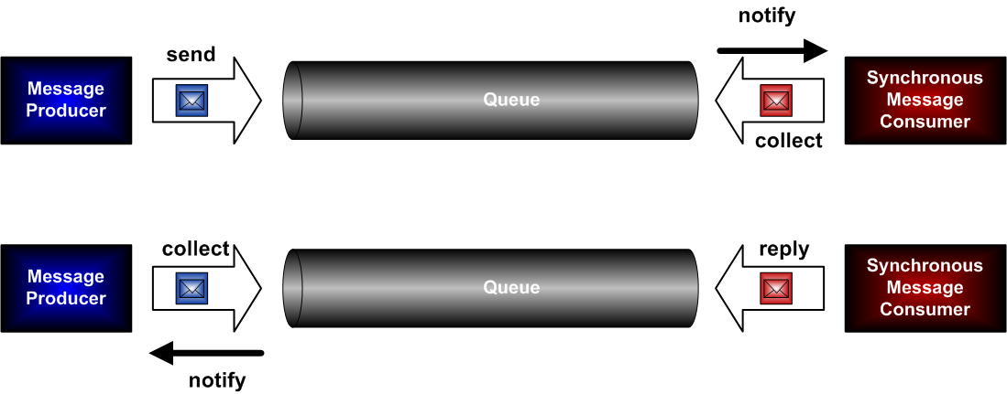
Asynchronous Messaging
6 separate sessions for exchanging all messages
No need for stateful protocol, so any stateless protocol without session support can be used (based on UDP sockets, or similar - i.e., SMS, SNMP, MQ, SQS, etc.)
Notification mechanism needed on both sides (PUSH)

Slide 7
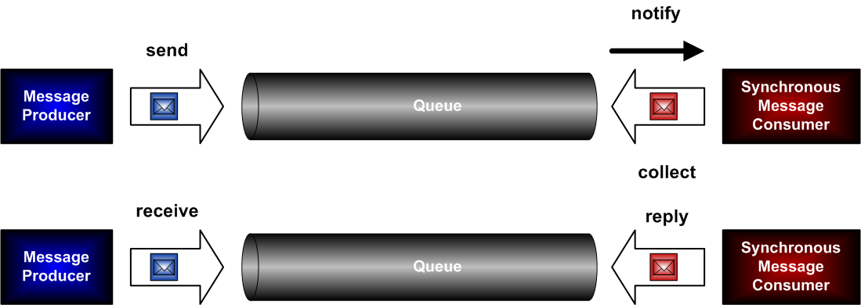
Combined Synchronous/ Asynchronous Messaging
Several (5) different sessions for exchanging the messages
Notification mechanism needed only on server-side
Very simple client – just send and receive methods

Slide 8
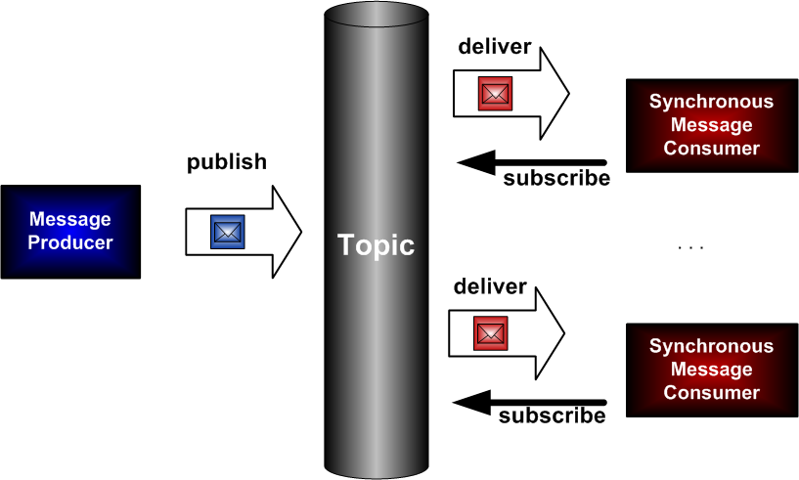
Publish/Subscribe Messaging Architecture
Sessions unnecessary – the entire information is in the group (topic setup) and individual (subscription)
Only one message provider, but multiple consumers (suitable for news broadcasting)
Only one posting, but multiple responders (suitable for feedback collection)

Slide 9
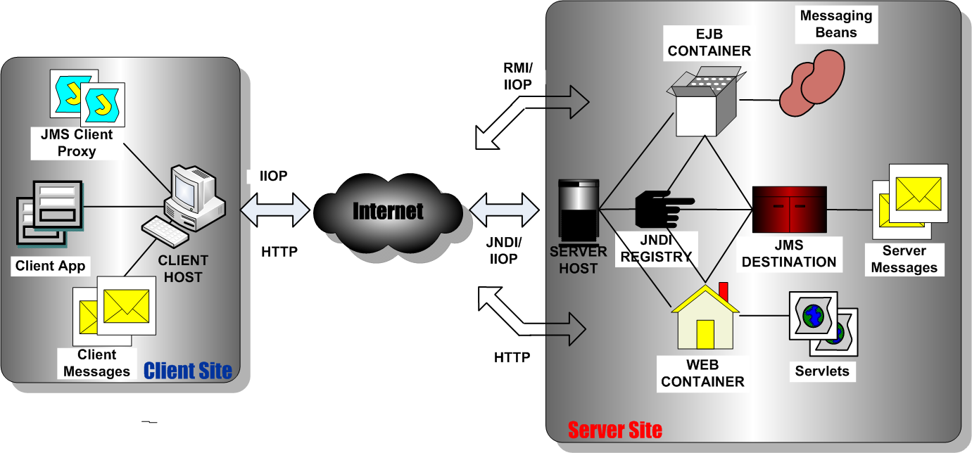
2 Java EE Messaging Applications

Slide 10
2.1 Messaging Protocols
Several protocols can be used for messaging (i.e., SMS, SNMP, POP, HTTP, IIOP), but only HTTP and IIOP are supported by the Java EE APIs
HTTP is stateless, so synchronous messaging cannot be implemented using it; it is used in Java Mail applications for sending emails over the Web only
IIOP is stateful, so both synchronous and asynchronous messaging can be implemented using it; it is used in JMS applications for synchronous or asynchronous messaging over the Internet

Slide 11
2.2 Messaging Clients
Java EE supports several types of JMS messaging clients on the server host
  Session Beans (within EJB container)
  Message Beans (within EJB container)
  Servlets (within Web container)
  Standalone Applications (within embedded EJB container)
Java SE supports only one type of JMS messaging client on the client host
    Desktop Applications (within Java SE container)

Slide 12
2.3 Message Destinations
Java EE supports two types of message destinations within the JNDI namespace of the server
  JMS Message Queues: for point-to-point distribution of the messages – each message has only one consumer, which is responsible for collecting the message from the queue; after that consumption the message is deleted
  JMS Message Topics: for broadcasting of the messages to a set of consumers, registered as subscribers of the topic; the messages remain in the topic until they are distributed to all subscribers

Slide 13
2.4 Messaging Service Providers
The messaging service providers in Java EE applications implement JMS specification (JMS provider)
The JMS providers can reside in different tiers of the Java EE Application architecture – the frontend, the middle tier, the backend or in an external tier
The JMS provider can be integrated with the Java EE server itself (i.e., Jboss Messaging, Glassfish MQ), packaged with an external service provider like the database server (i.e., Oracle PL/SQL AQ package inside the DB), or provided as a separate product (i.e., IBM MQ Series, Open JMS)

Slide 14
Possible Roles of Java EE Components
Component | Producer | Synchronous Consumer | Asynchronous Consumer
Servlets | Preferred | Possible, but not recommended | Impossible
Session Beans | Possible | Possible, but not recommended | Possible, but not recommended
Message-driven Beans | Possible, but not recommended | Impossible | Preferred
Desktop Application | Preferred | Possible, but not recommended | Possible, but not recommended
Web Applets | Possible, but not recommended | Impossible | Impossible

Slide 15
3 JMS API
JMS API consists of a set of interfaces and classes for
  Creating new messages
  Organising the distribution of the messages using different methods (i.e., point-to-point or publish/subscribe)
  Delivering the messages to their intended destinations (i.e., message queues and topic tables)
  Notifying the destinations about new messages arrival
  Retrieving the messages from their destination
JMS client has to
  Create the original messages or the replies
  Locate the destinations using JNDI API
  Send the messages to the destination
  Receive the response
  Pre-process and post-process the messages

Slide 16
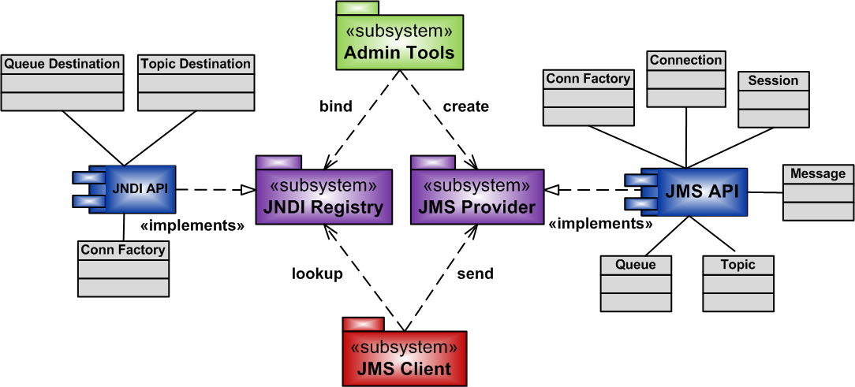
Structure and Components of JMS API

Slide 17
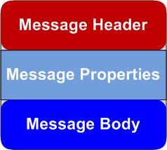
What is in the messages?
Header: Information for identification and routing of the messages to the destination
Properties: Property/value pairs with information for classification and filtering of the messages, and for inter-operability with some messaging providers
Body: Actual message in standard type format

Slide 18
Message content types
Message Type | Message Body Contents
TextMessage | Java object of type java.lang.String
BytesMessage | Stream of binary data
StreamMessage | Stream of Java primitive datatypes data
MapMessage | A Java set of name/value pairs (i.e., hashtable)
ObjectMessage | A serializable Java object

Slide 19
4 Using JMS API for processing messages in J2EE applications
Main Tasks:
  Creating the message producer
  Creating the messages
  Sending and receiving the messages
  Creating the message consumer

Slide 20
4.1 Creating a queue message producer using JMS
Obtain a reference to the QueueConnectionFactory object (using JNDI or dependency injection if in the same container)
Obtain a reference to the Queue object (using JNDI or dependency injection if in the same container)
Creating a Connection object using the factory object (encapsulates the virtual connection to the message service provider)
Creating a Session object using the connection object to provide the context of the messages
Creating a QueueSender or MessageProducer using the session object to enable sending the messages

Slide 21
Create Message objects using the session object from appropriate type
Populate the messages with data using appropriate methods for the type of message (i.e., setText() method of TextMessage)
Send the messages using the method send() of QueueSender or MessageProducer object

Slide 22
Example: Obtaining reference to a JMS destination using JNDI
try {
QueueConnectionFactory myQueueConnFact =
(QueueConnectionFactory)
jndiContext.lookup(“jms/MyQueueConnFactory”);
Queue myQueue = (Queue) jndiContext.lookup(“jms/MyQueue”);
} catch (NamingException e) {
... // if not bound
}

Slide 23
Example: Servlet as a Message Producer
import java.io.IOexception;
import javax.annotation.Resource;
import javax.jms.*;
import javax.servlet.*;
import javax.servlet.http.*;
import javax.servlet.annotation.WebServlet;
@WebServlet (“/MyJMSProducer”)
public class MyJMSServlet extends HTTPServlet{
@Resource (mappedName = “jms/MyQueueConnFactory”)
javax.jms.QueueConnectionFactory myQueueConnFact;
@Resource (mappedName = “jms/MyQueue”)
javax.jms.QueueConnectionFactory myQueue;
protected void processRequest(HTTPServletRequest request,
HTTPServletResponse response)
throws ServletException, IOException{
... // here we send the message
}
}

Slide 24
(cont.) Sending a message to a queue from servlet
String myTxt = request.getParameter(“txt”);
try{
Connection myConn = myQueueConnFact.createConnection();
Session mySess =
myConn.createSession(false,Session.AUTO_ACKNOWLEGDE);
TextMessage myMsg = mySess.createTextMessage(myTxt);
MessageProducer myProd = mySess.createProducer(myQueue);
myProd.send(myMsg);
myProd.close();
mySess.close();
myConn.close();
response.sendRedirect(“JMSBrowser”);
}

Slide 25
(cont.) Recovering from errors in the servlet
catch (JMSException e){
request.setAttribute(“exception”, ex);
requestDispatcher myReqDispatch =
request.getRequestDispatcher(“JMS_Err.jsp”);
myReqDispatcher.forward(request,response);
}

Slide 26
4.2 Creating Queue Message Browser
Special servlet for investigating the queue of messages in the external messaging service provider
Performs only read-only queue processing operations
Does not consume the messages – i.e., they remain in the queue for processing by the corresponding beans

Slide 27
Example: Servlet Message Browser
import java.io.IOexception;
import javax.annotation.Resource;
import javax.jms.*;
import javax.servlet.*;
import javax.servlet.http.*;
import javax.servlet.annotation.WebServlet;
@WebServlet (“/MyJMSConsumer”)
public class JMSBrowser extends HTTPServlet{
@Resource (mappedName = “jms/MyQueueConnFactory”)
javax.jms.QueueConnectionFactory myQueueConnFact;
@Resource (mappedName = “jms/MyQueue”)
javax.jms.QueueConnectionFactory myQueue;
protected void processRequest(HTTPServletRequest request,
HTTPServletResponse response)
throws ServletException, IOException{
...
}
}

Slide 28
(cont.) Browsing the message queue
List<TextMessage> myMsgList = new ArrayList<TextMessage>();
try{Connection myConn = myQueueConnFact.createConnection();
Session mySess =
myConn.createSession(false,Session.AUTO_ACKNOWLEGDE);
QueueBrowser myMsgBrows = mySess.createBrowser(myQueue);
Enumeration myMsgEnum = myMsgBrows.getEnumeration();
while (myMsgEnum.hasMoreElements()){
Object myObj = myMsgEnum.nextElement();
if (myObj instanceof TextMessage)
myMsgList.add((TextMessage) myObj);
}
myMsgBrows.close();
mySess.close();
myConn.close();
request.setAttribute(“messages”, myMsgList);
RequestDispatcher myDispatch =
request.getRequestDispatcher(”My_Msg_List.jsp”);
myDispatch.forward(request,response);
}

Slide 29
(cont.) Recovering from errors while browsing the queue
catch (JMSException e){
request.setAttribute(“exception”, ex);
requestDispatcher myReqDispatch =
request.getRequestDispatcher(“My_Msg_Err.jsp”);
myReqDispatcher.forward(request,response);
}

Slide 30
5 Message beans as asynchronous consumers in Java EE applications
Messaging beans and JMS API
  Defined as implementation of JMS API MessageListener interface
  Programmed to provide the code of the implementation of the listener methods
Messaging beans and EJB container
  Registered with JNDI to map the name of the bean to a destination of the messages
  Deployed to the EJB container using the deployment descriptor faces-config.xml and/or annotations
  Managed by the container automatically in a pool of beans, which remains transparent to the client

Slide 31
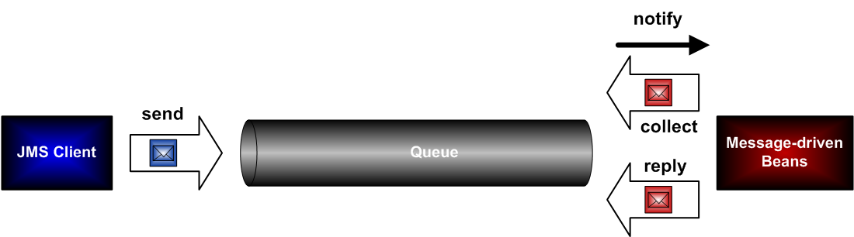
Message Beans in Action
The bean defines the implementation of onMessage() method of the MessageListener interface
The container maintains a pool of beans for each destination
Upon arrival at the destination Java intercepts the event and executes onMessage() method of an available bean
The bean extracts the message and processes it
After finishing the processing, the bean posts the response as another message to the destination

Slide 32
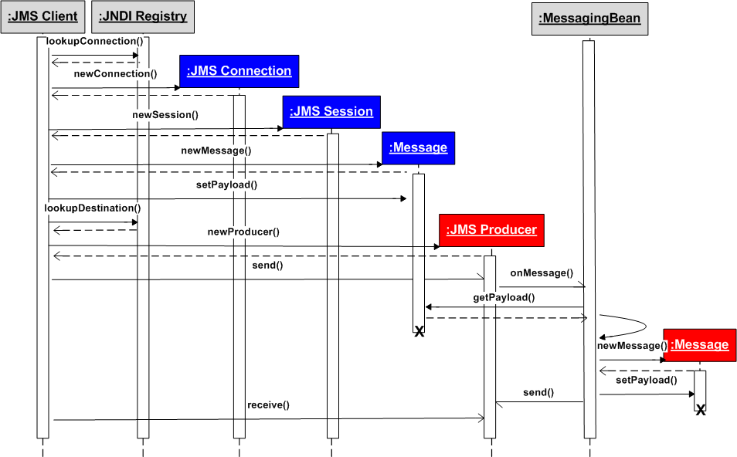
Message routing

Slide 33
Message Processing
Each message is processed by a separate bean instance, chosen from the pool of available beans by the container automatically
The beans operate within their own context, stored in the MessageBeanContext object
They are transparent to the user (anonymous), do not participate in user transactions (stateless) and their security is managed by the container (container scope)
After the processing is finished the response message is posted back to the destination and the bean instance is released back in the pool

Slide 34
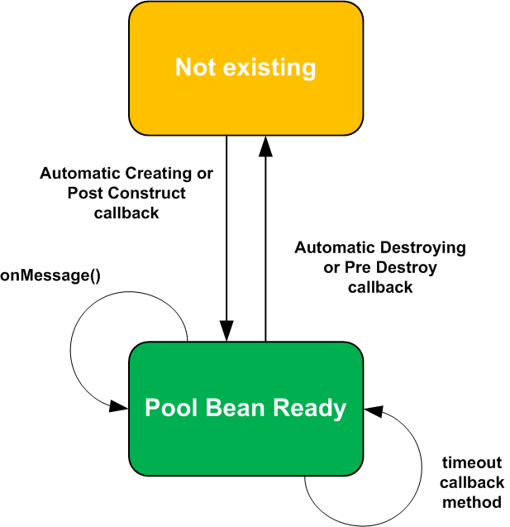
Message Beans Lifecycle

Slide 35
Lifecycle methods
Automatic creating – available to the container as the bean factory method newInstance()
PostConstruct() callbacks – defined by the bean developer
MessageDrivenContext() – defined by the bean deployer
PreDestroy() callbacks – defined by the bean developer
Automatic destroying or timeout callback – available to the container through the MessageBean interface

Slide 36
6 Developing Message EJBs
6.1 Creating the beans
Java classes which confirm to the JMS API (other specific messaging API also possible)
  Public and not final (must allow extensions)
  Must include public zero-argument constructor which will be used by the container to instantiate the bean
  Implement javax.jms.MessageListener interface to allow the container to manage them at runtime

Slide 37
Annotated with @javax.ejb.MessageDriven to instruct the container to register them with JNDI and to deploy them to the message-driven pool
@MessageDriven (mappedName = “jms/MyQueue”,
activationConfig = {
@activationConfigProperty (
propertyName = “destinationType”,
propertyValue= “javax.message.Queue”)
}
)
...
  Implement onMessage() method to allow the container to invoke the bean when a new message arrives at the destination

Slide 38
Example: Template for writing JMS-based message EJBs
import javax.jms.*;
import javax.ejb.*;
@MessageDriven (mappedName = “jms/MyMsgHandler”,
activationConfig = {
@activationConfigProperty (
propertyName = “destinationType”,
propertyValue= “javax.message.Queue”)
})
public class MyMsgBean implements MessageListener{
public MyMsgBean() {
... // constrictor method
}
public void onMessage (Message msg){
... // handler method
System.out.println (“Message consumed”);
}
}

Slide 39
6.2 Adding Lifecycle Event Handlers
(Optional since EJB 3.0)
Can have public, private or protected access
Mustn’t throw any application-specific exceptions, only standard runtime exceptions (so that they can be processed by the container automatically)
Mustn’t use any transaction-specific or security-specific context resources (as before)
Typically placed inside the bean, although in principle they can be programmed externally, using helper classes

Slide 40
Example: Specifying Lifecycle Callback Methods inside the Bean
public class MyMsgBean{
@Resource private MessageDrivenContext msgctxt;
public MyMsgBean(){...}
@postConstruct void obtainContainerResources(){...}
@preDestroy void releaseContainerResources(){...}
public void onMessage(Message msg) {...}
}

Slide 41
7 Creating Remote JMS Clients of Java EE Applications
Libraries needed
  JNDI API (part of Java SE)
  JMS API (part of Java SE)
  Java EE client API (Glassfish specific implementation of the standard Java EE client API)
  JMS Messaging Service provider API (in our case this is MQ server, which is bundled with Glassfish)
Operations used
  Locating the JNDI registry on the remote server and setting the context for searching the registry
  Lookup for the message consumer and obtaining the proxy of its message queue
  Establishing communication session with the consumer
  Sending the message to the queue

Slide 42
Example: Sending a text message
// Specify the details of a remote JMS Client
Properties props = new Properties();
props.put (Context.PROVIDER_URL,”mq://localhost:7676");
// Create an initial context for JNDI repository lookup
InitialContext cntxt = new InitialContext(props);
System.out.println ("Context Created");
// Perform JNDI Lookup for the queue connection factory
QueueConnectionFactory qFactory =
(QueueConnectionFactory) cntxt.lookup
("jms/UpdateStudentConnectionFactory");
// Create a connection using the queue connection factory
Connection conn = qFactory.createConnection();
System.out.println ("Connection established");
// Initialise the communication session
Session sess = conn.createSession (false,
Session.AUTO_ACKNOWLEDGE);

Slide 43
(cont.)
// Create a new message in the session
TextMessage msg = sess.createTextMessage ();
msg.setJMSDeliveryMode (DeliveryMode.NON_PERSISTENT);
msg.setText (txt);
// perform JNDI Lookup for the remote JMS Provider queue
Queue q = (Queue) cntxt.lookup ("jms/UpdateStudent");
// Create a MessageProducer instance for this communication
// session using the queue session we already have
MessageProducer mp = q.createProducer (sess);
// Send the message to the provider’s queue
mp.send (msg);
System.out.println ("Message Sent: " + txt);

Slide 44
Summary: JMS vs. other methods of messaging
 | JMS | SMS/MMS | SOAP
Data types | Serializable Java object data types | Standard MIME data types | Standard and XML object data types
Memory Limitations | No | Yes | No
Use of the com protocol | IIOP sessions increase the Reliability | Sessionless transmission | HTTP Sessionless transmission
Use of the Middleware | JMS listeners for event processing JNDI for naming | Limited to the URL mapping | SOAP proxies, XML binding

